Slide 1
Build and Deploy Microsoft Teams Messaging Extensions App
Jenkins NS
Founder of JPOWER4
@jenkinsns

Slide 2


Sponsors

Slide 3









Hi! I am Jenkins NS
Founder, JPOWER4
http://www.jpower4.com
@jenkinsns
SPFx: https://www.facebook.com/spfxinfo/
MS Teams: https://www.facebook.com/msteamsinfo
Github : https://github.com/jenkinsns
My Blog : http://www.jenkinsblogs.com

Slide 4
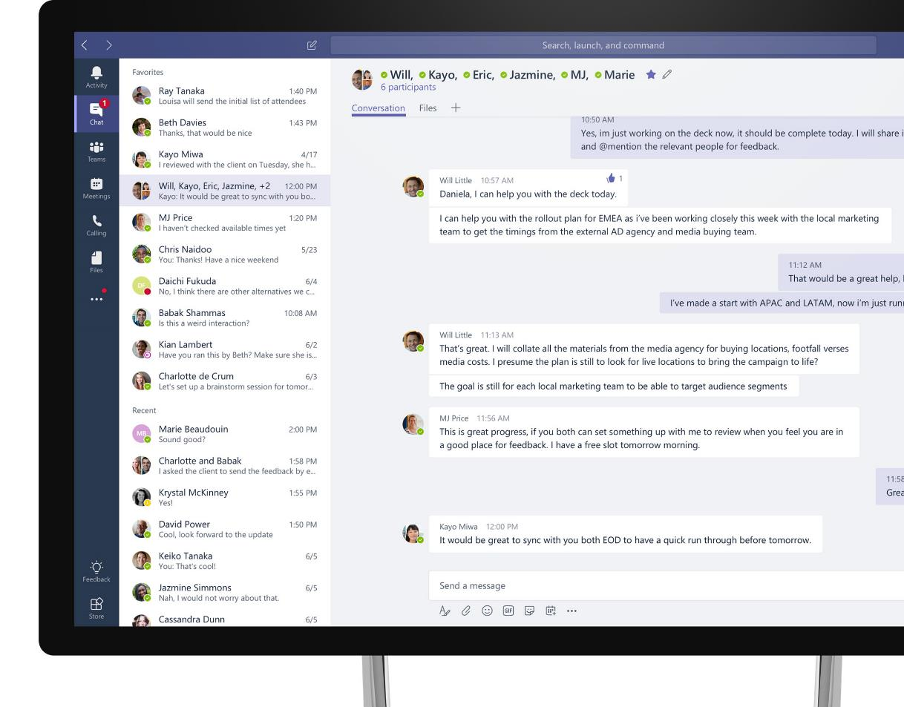
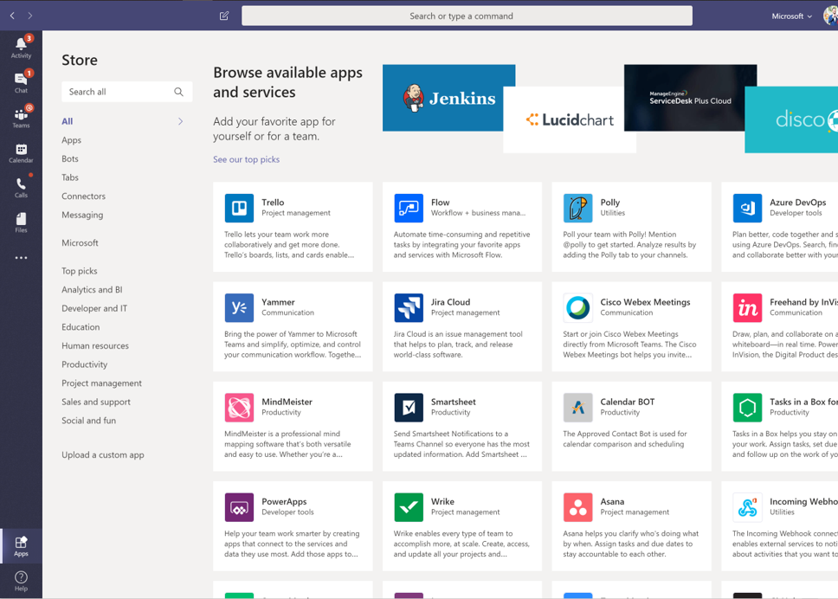
Microsoft Teams
The hub for teamwork in Office 365
Communicate
through chat, meetings & calls
Collaborate
with deeply integrated Office 365 apps
Customize & Extend
with external apps, automation, process flows, and custom apps
Work with confidence
enterprise level security, compliance, and manageability
Notes:
[This is an animated slide. Please show it in presentation mode]
[MAIN POINT TO LAND]
Microsoft Teams is a hub for teamwork, a chat-based workspace that enables teams to be more productive by giving them a single and secure location that brings together everything a team needs: chats, meetings, calls, files, and tools. Microsoft Teams is one place for all the needs your teams have.
Microsoft Teams delivers on four core promises to create a digital workspace for high performing teams.
[COMMUNICATE]
First, Microsoft Teams solves for the communication needs of a diverse workforce.
Since preview, Microsoft Teams has evolved to a complete meetings and calling solution, incl. chat, voice and video, as we have completed our roadmap for bringing Skype for Business Online features and functionality into Teams. You can use Teams for informal 1:1 or group chats – directly on your phone if you’re on the go. Or you can have an open conversation in a channel. This enables people to share information in a transparent way to accelerate decision making. And it's super easy to move from a chat into a face to face meeting, helping you to bridge geographical barriers.
[COLLABORATE]
When it comes to collaboration, the deep Office integration enables today’s multigenerational workforce to use the Office apps they are familiar with and love - Word, Excel, PowerPoint, OneNote, SharePoint, Planner, even Power BI - right within the context of Teams.
You can avoid email attachments and having to search for the latest version of a document. Teams brings all the Office 365 services together – so that you can easily share and co-author files.
[CUSTOMIZE]
Many of you use other services than Office 365 as well which results in you having to jump between and spend time in disparate experiences. We built Teams to be the hub for all the services and tools your teams use on a day to day basis. So, you can customize Teams with tabs, connector and bots to include the apps and services you need - <mention relevant 3rd party apps like GitHub and Trello>. We have also created an extensible platform, to enable building apps and to integrate with business processes.
And for Firstline workers, Teams provides an additional set of capabilities including schedule management.
[WORK WITH CONFIDENCE]
Microsoft Teams comes with the enterprise grade security, compliance and manageability that you expect from Office 365 which customers tell us is a huge value add for them.
------
And that product is Microsoft Teams.
And back to that Satya quote we shared earlier about Microsoft as a platform company,
Core to the value of Teams is also the platform that it’s built upon.
(click slide to build)
which enables you to customize & extend your experience.
Today, we will discuss how to unleash the real power of Teams to and create experiences
that help solve the communication challenges we mentioned earlier,
and deliver experiences that most organizations have only dreamt about.
Now, why is a platform important? Because while every team is unique,
one thing that is consistent is that every team will need a variety of apps and tools to get their work done.
Since there is no such thing as a universal tool for work, the extensibility of the Teams platform
delivers a universal hub for teamwork to infuse all those tools, together.
Let us show you what we mean by infusing your tools, together.

Slide 5



































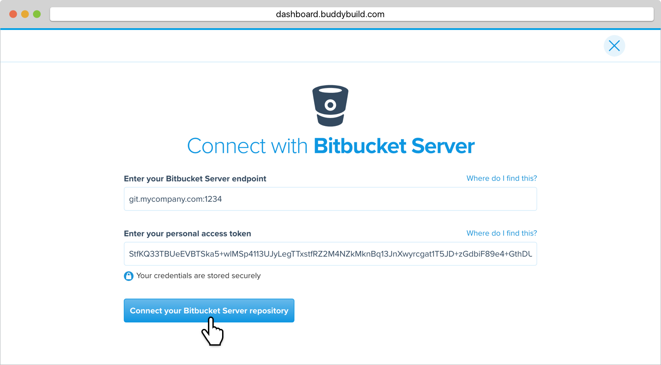




Notes:
These are few of many companies who are building and porting their existing apps to Teams.

Slide 6




Capabilities
Extensible platform
Bots
Tabs
Build apps with a rich set of capabilities to enable these higher performing teams and reach your users in their chats, channels, notifications, and personal workspace.
Drive engagement by submitting your app to the Office Store.
Help users get tasks done in calls, conversations and online meetings
Surface rich content within Teams
Notifications
Messaging extensions
Engage users via channel & feed notifications
Allow users to query and share rich cards in conversations
Commands and Actions
MS Graph
Power your apps using Graph. Automate teamwork and add richness using data from M365
Trigger commands to kick off workflows or search content
Scopes
Publishing Modes
Sideloading
App Store
Company Store
Team
Personal
Collaborative experiences
Productivity experiences
For testing and development
ISVs building for Teams
Deploy using private app store
Notes:
As I mentioned, we’re building a platform and Teams is a very extensible platform with many capabilities.
Think of this as the way for your employees to interact with your application or for your application to interact with employees.
Whether that’s through chats, channels, notifications, or in their personal workspace on their Teams workspace.
Some of these are bots. Most people are familiar with bots. One popular one would be where you’re asking questions and getting answers by just pulling up a bot.
Tabs give you a rich surface, where you can really post your application in any of the information from your app in a tab so it’s right there for users or you can actually post an application in a tab.
Notifications, whether it’s in a feed or whether it’s in a channel so you can notify people for example if something changed in your application that you’re extending into Teams, you can provide that notification to users.
Messaging extensions are a way to provide a way for people to actually pull something up, and query and share rich cards in conversations and by the way users can take actions on those cards give you input back and based on that input you provide additional information.
You have command and actions that could either kick off a workflow source search content.
Again, one of the things that’s important to think about is you have the ability to put something in a team environment where it’s something that for example, putting in a channel with multiple people, or you’re putting into someone’s personal channel where it’s really something geared just for the individual and in terms of how can you publish things.
We do allow you to sideload things for testing and development.
If it’s a fully customized packaged solution, that’s something you could build and publish in the Teams app store or if it’s a custom application, that’s really been customized for just one individual customer, that’s something you can deploy using the app store.
Think of each customer as having a private app store for their company where you can load it.

Slide 7


















Evolve how your people work, with the tools they need
Vertical solutions
Healthcare
Manufacturing
Retail
Banking
Custom
Apps
Organization-based applications
Departmental tools
Employee resources
Support & info
Processes & workflow
Partner applications
Ready to use
Office 365
applications
Notes:
(first slide build is auto)
So one of the beauties of Microsoft Teams is that Teams really is the hub for where people get work done and so they want to make sure that all the tools they need are a part of Teams.
So they don’t have to change contacts and we think of this as two different types of applications.
The first part of customizing and extending Teams is bringing together all the Microsoft Office applications you know and love, allowing you to reduce context switching and create conversations around content.
(click to build)
The second part of this infusion of tools is where we bring together all the other apps and services you need every day to get your job done, whether or not Microsoft built them.
Our Teams store currently has over 250 of our partner applications and integrations available today, and growing.
Just to clarify the point, these first two layers here are ready to use applications available for you
As soon as you download Teams, should your IT admins make them available to you.
(click slide to build)
Finally, this is where things get interesting. Microsoft Teams also gives you the ability to extend
Your experience to leverage the apps and services that your organization has built for you.
The tools you need to leverage every day as an employee to get work done and as part of your role.
We call these line of business applications.
Now, when you look at this picture, it’s exciting. Imagine a day where all your applications
(click to build slide)
not only show up in one single UI, but also work better together, allowing you to stay in the flow of your work.
That day is here and it’s time to deliver your people the modern workplace they deserve
And make their apps work for them

Slide 8
App scenarios across industries and horizontals…
Industry vertical
Airlines, transportation
Flight/route crew communication hub
Local crew shift management
Mining, oil, and gas
New location development
Daily quality monitoring and analysis
Manufacturing
Key accounts inventory, logistics
Change order services
Financial services
Proposal Manager for commercial banking
Content sharing with compliance
Government
Emergency/disaster response and recovery
Citizen service: permitting and licensing
Power and utilities
Field service real-time remote assist
Billing and customer management
Retail and consumer goods
Supply chain real-time collaboration
Shift, pricing, and inventory management
Healthcare
Patient care coordination
Telemedicine
Real estate and construction
Leasing office tenant management
Real estate customer engagement
Horizontal
Marketing
Brand partnership hub
Industry event planning
Marketing hub
HR
Recruiting tool
New hire onboarding and support tools
Project management
Billable hours management
Client engagement hub
Service desks
Self-service knowledge base
Customer service desk
Procurement center service
Firstline workers
Shift management
Remote worker task management
Notes:
These types of business solution opportunities around Teamwork are pretty much endless!
From airline, retail, healthcare, legal firm, real estate, different industries and different functions. You can envision with your customers, understand their business process and teamwork needs, and connect Teams to the tools and services they use everyday to help them fully realize Teams’ value. This purpose of this slide is to give you some ideas, to start thinking about what your customers need.

Slide 9

Easy to distribute to your customers
Publish to the store
Make your app available to the world. Let people know the category of your service, include screenshots and videos and easy to access app details that show off your app’s capabilities and skills.
Publish to your tenant
When your app is designed to support a specific function in your company you can make it easy to find for all your company’s users. We’ve got a great place for your admin to host all your internal apps and they can suggest publicly available apps here too.
Publish to a team
When you want to test your app or if it was designed for a specific group of people you can sideload your app and use it right away.

Slide 10
















Reference Architecture
Partner Solution Azure: Bot Framework, LUIS, Cortana, AI, Cognitive Services etc.
Your App
Tabs
Bots
Adaptive cards
Messaging extensions
Task modules
Notifications
Interface
Teams Application Platform & Graph APIs
Azure
Business Logic
Business Logic
Back-end
SPFx
Microsoft 365 Cloud
Organizations own their data / organizations give developers access
Private/Public Cloud
Line of Business (LOB) apps
ISV solutions
SharePoint solutions
On Premise
Line of Business (LOB) apps
ISV solutions
SharePoint solutions
Healthcare
Retail
Manufacturing
Transportation
Hospitality
Financial Services
Public Sector

Slide 11
Messaging Extensions

Slide 12
A Microsoft Teams app
Your Microsoft Teams App
Application
app.zip
Web pages with server side and client side logic
manifest.json
Web API—for Bots and business logic
color.png
Azure portal & Outlook Connector portal
outline.png
Background jobs
Bot Framework channel registrations
Outlook Connector registrations

Slide 13
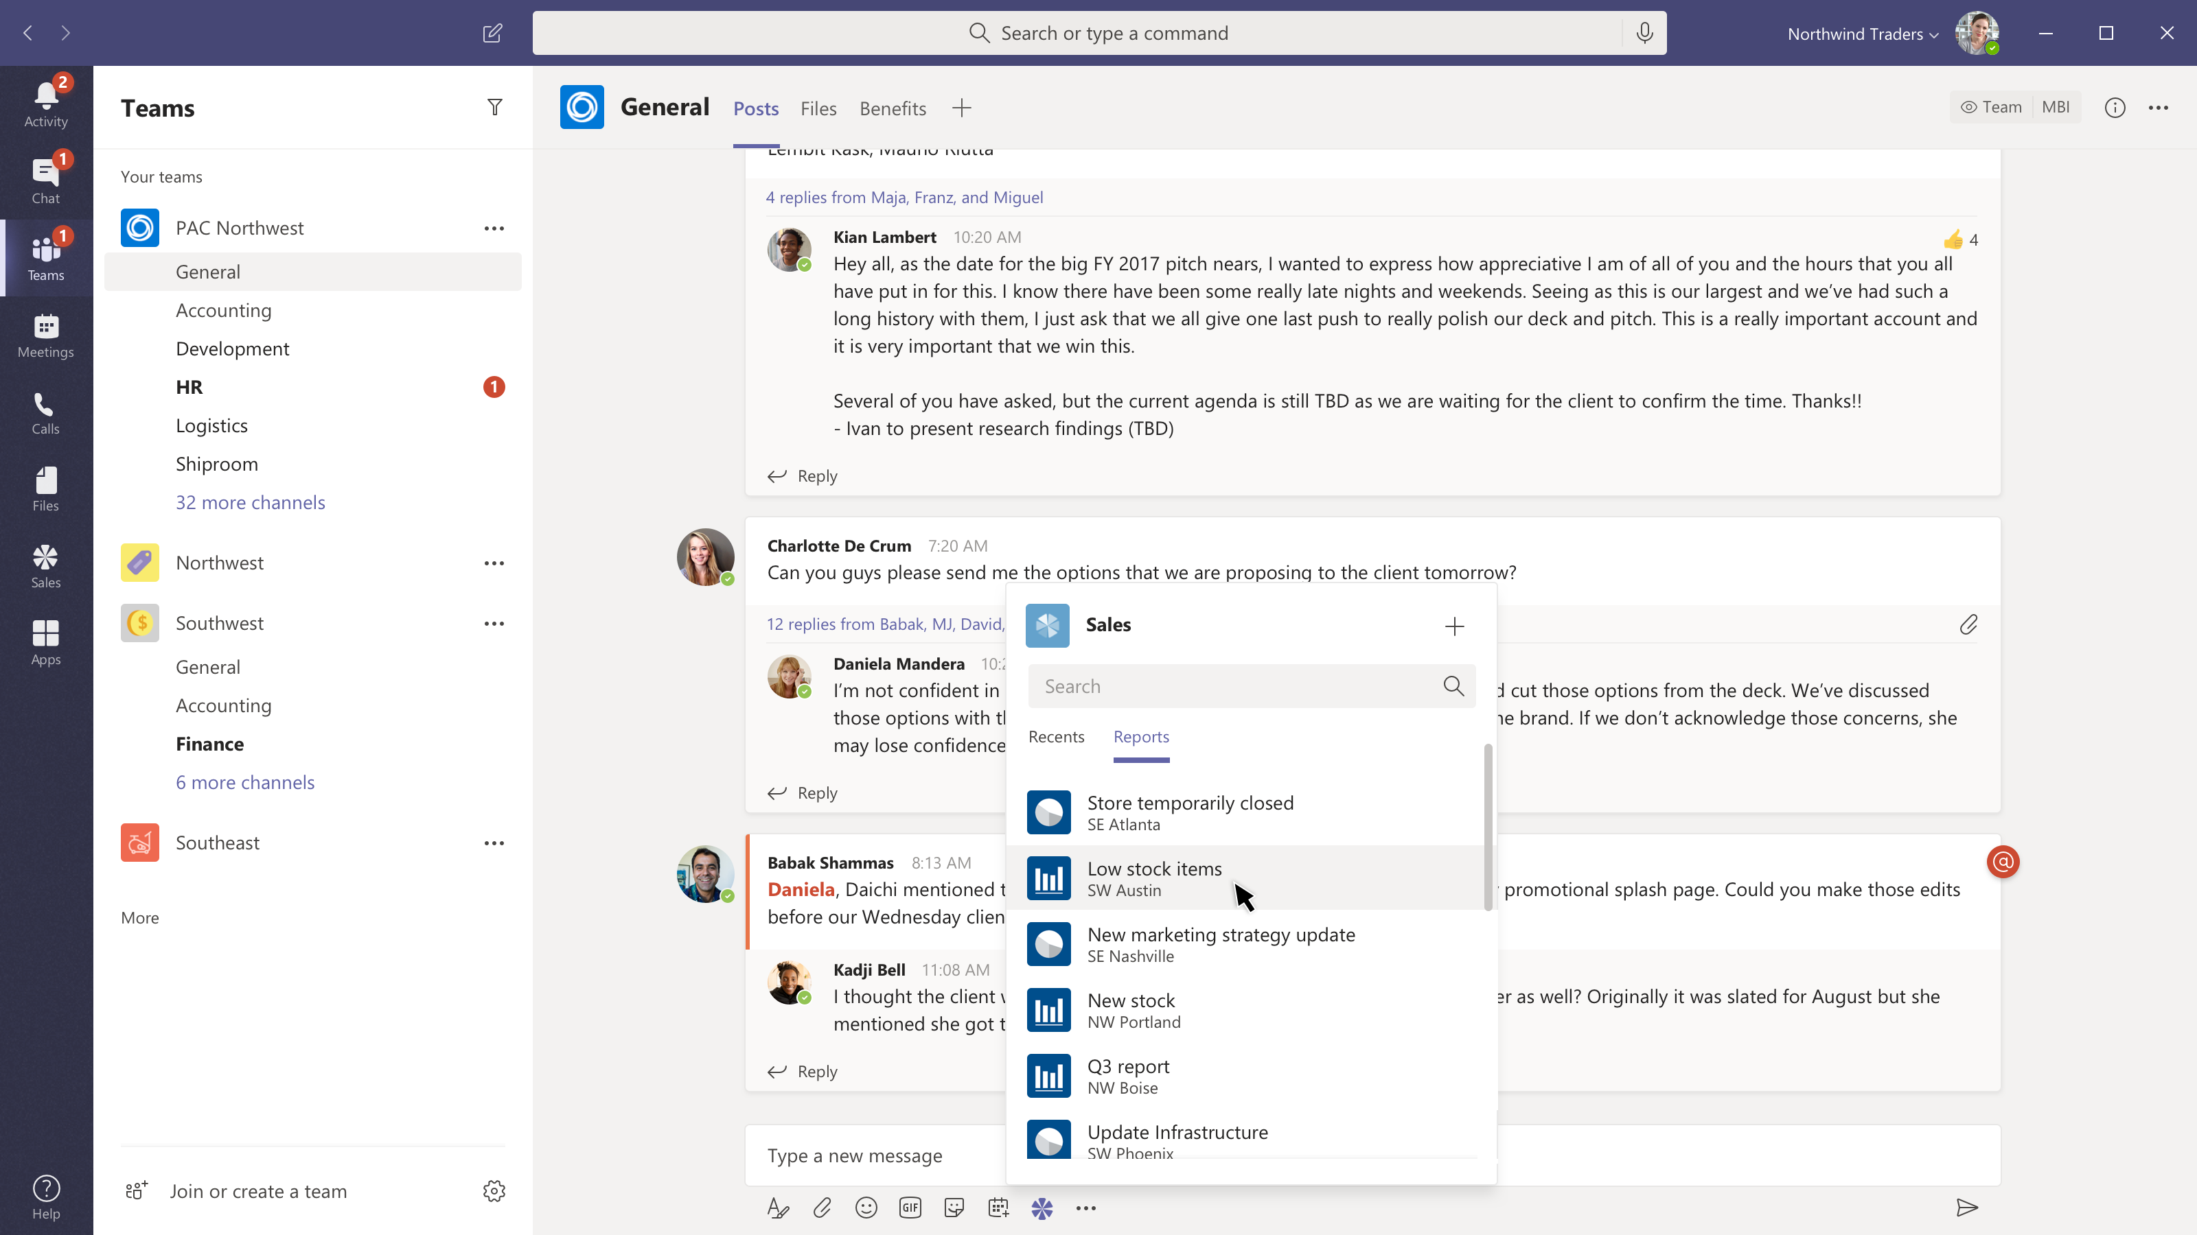
Share a sales report
Message extensions
Search for or show recently viewed reports.

Slide 14
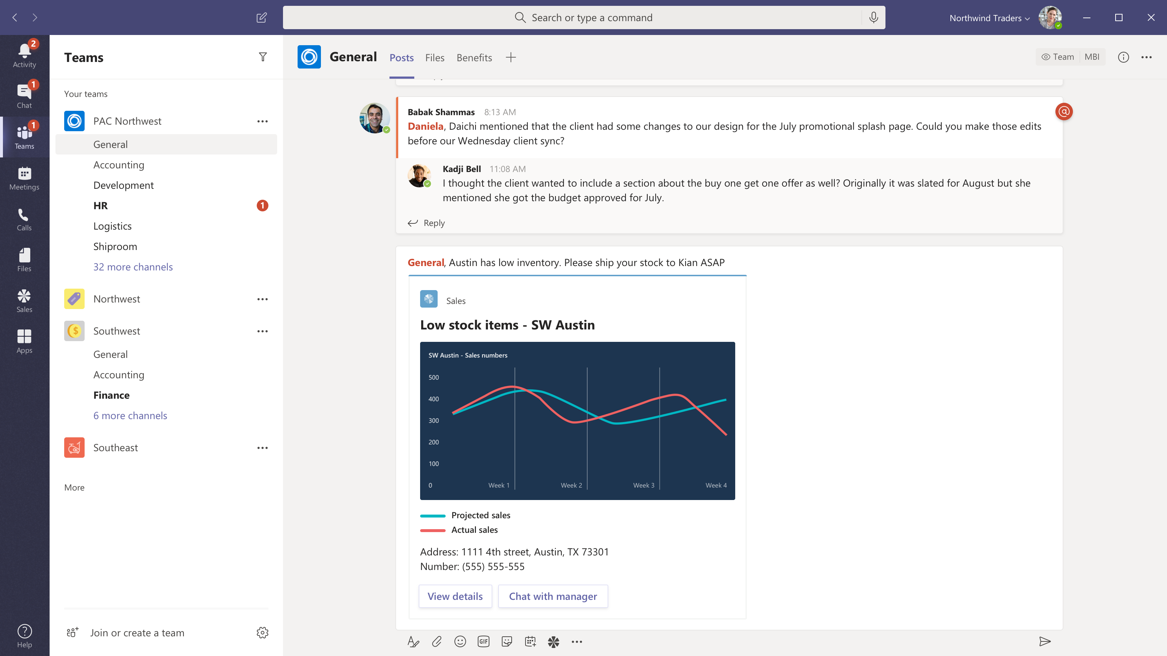
Share a sales report
Message extensions
Search for or show recently viewed reports.
Compose with card
Add comments and @mention the people who need to see the information.

Slide 15
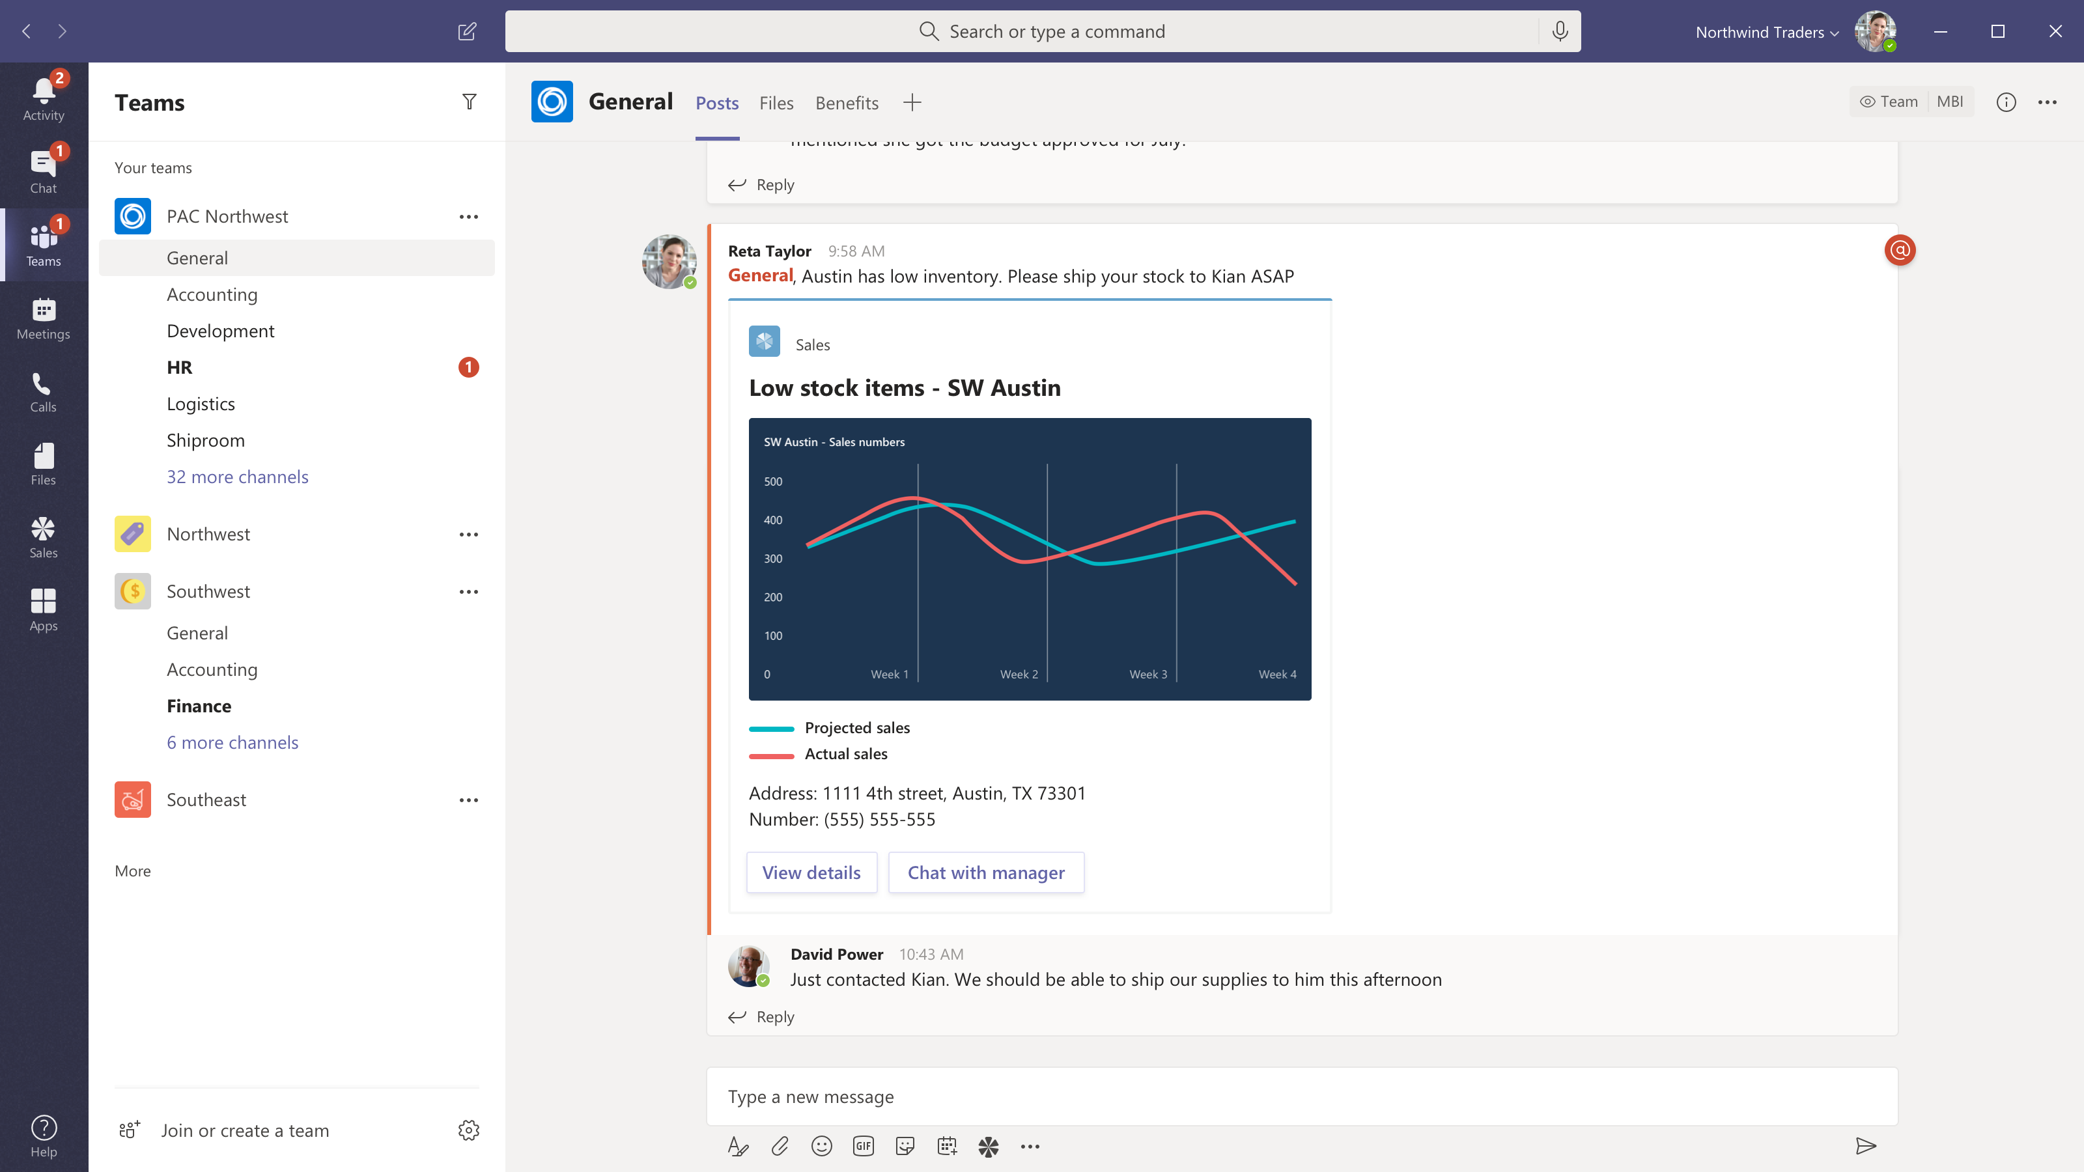
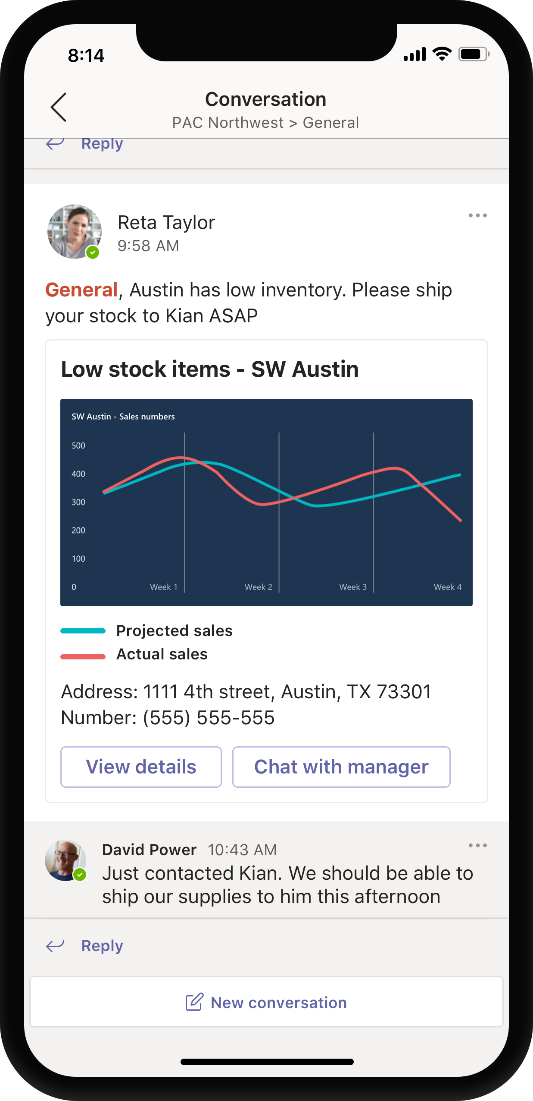
Share a sales report
Message extensions
Search for or show recently viewed reports.
Compose with card
Add comments and @mention the people who need to see the information.
Share to team
Now everyone can see the summary, open a link to your content or take immediate action right from the chat.

Slide 16
Demo Message Extension

Slide 17
Install yo (Yeoman), gulp-cli (Gulp global command line interface) and typescript (Typescript compiler) globally using NPM
npm install yo gulp-cli typescript –global
Install generator-teams globally using NPM.
npm install generator-teams –global
yo teams
gulp build
code .
Bot Channel Registration in Azure
gulp ngrok-serve --debug --no-linting
ngrok http 5000 --host-header=localhost:5000
node getBooks.js

Slide 18
Any Questions?

